Slide 1
E-Learning and MOOCs:
a Short Investigation in the Context of the FETCH European Thematic Network
Betim ÇIÇO, (b.cico@seeu.edu.mk) South East European University (Republic of Macedonia) Marco PORTA,(marco.porta@unipv.it) University of Pavia (Italy)

Slide 2
Outline
MOTIVATION
Introduction
THE QUESTIONNAIRES AND RESPONSES
E-learning
MOOCs
DISCUSSION and Remarks
CONCLUSIONS

Slide 3
Motivation
The investigation was carried out in the context of the FETCH European Thematic Network:
Future Education and Training in Computing: How to support learning at anytime anywhere
http://fetch.ecs.uni-ruse.bg/?cmd=gsIndex
WP -3 TASK T1:
Defining best curricula and syllabi for bachelors, masters and doctorates in CS, CE, SE and IS, as well as for their implementation in higher education institutions;
Establishing best teaching modalities.

Slide 4
Motivation
To present the results of an online survey on e- learning and MOOCs
Four areas:
Computer Science (CS)
Computer Engineering (CE)
Software Engineering (SE)
Information Systems (IS)
Three categories of respondents:
Professors http://goo.gl/fsNbHS
Alumni http://goo.gl/EkH9Ch
Industry Representatives http://goo.gl/sfjF2x

Slide 5
Motivation
Work packages, Summary of work packages of the FETCH
WP number | Work package type | Workpackage title
1 | Management | Project Management & Coordination
2 | Implementation | National and European frameworks for development of Higher Education until 2020
3 | Implementation | European Strategic Framework for Computing Education and Training 2020
4 | Implementation | European Evaluation Framework in Computing Education and Training 2020
5 | Implementation | Digital curricula in Computing Education and Training
6 | Implementation | e-Learning and m-Learning in Computing supported by social media
7 | Quality Assurance | Quality Assurance
8 | Exploitation of results | Exploitation of Project Results
9 | Dissemination | Dissemination of Project Results

Slide 6
Introduction
E-learning, main features:
Usually tailored to the student (instead of being characterized by the class)
The student has more control over topics (instead of subjects and rules being selected by the teacher)
Takes place when the student prefers (instead of being constrained by predefined timetables)
The teaching procedure occurs mainly by means of technology (instead of depending on the teacher’s will and competence)
Students act a proactive role (instead of playing a reactive role)

Slide 7
Introduction
Some challenges:
Motivation
Time management
Learning “how to learn” in a virtual environment
Assessments

Slide 8
Introduction
Massive Open Online Courses (MOOCs)
Share some of the principles of ordinary courses
Are taught over the Web to a very large number of students
Usually have no fees
No specific prerequisites
No predefined expectations
No formal accreditation

Slide 9
Introduction
Some challenges:
Handling course delivery for thousands of students at the same time entails a revision of the usual tutor-assisted e-learning model
Need for automated tools able to balance the lack of human attention
Scalability problems

Slide 10
QUESTIONNAIRES AND RESPONSES
Professors:
95 responses from 18 countries
almost all public universities or higher education organizations
MOOCs offered by very few respondents’ institutions (10)
Alumni
69 responses from 15 countries
Industry representatives
35 responses from 13 countries

Slide 11
…..questionnaires: e-Learning….
Professors, alumni and industry representatives all largely agree that e-learning:
is useful for both bachelor's and master's programs
is useful for PhD programs, although a little less markedly
should not be used as the only teaching modality (it should be combined with "traditional" learning)
Respondents were asked to rate, in a scale from 0 to 4, the benefit levels of some features of e-learning

Slide 12
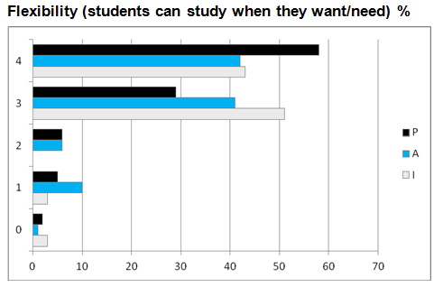
…..questionnaires: e-Learning….

Slide 13
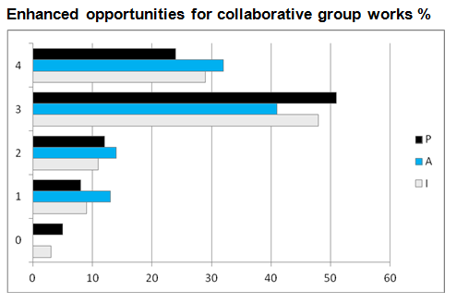
…..questionnaires: e-Learning….

Slide 14
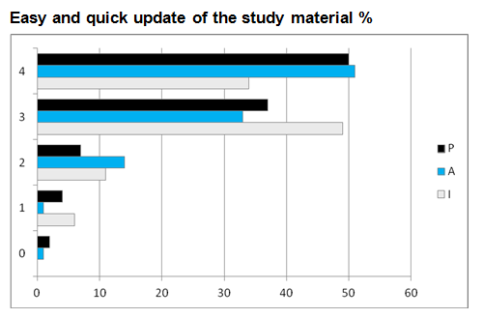
…..questionnaires: e-Learning….

Slide 15
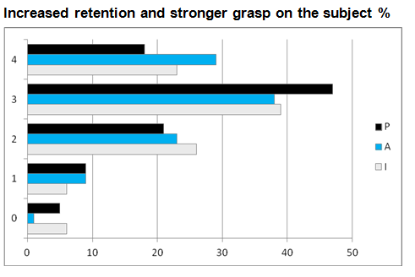
…..questionnaires: e-Learning….

Slide 16
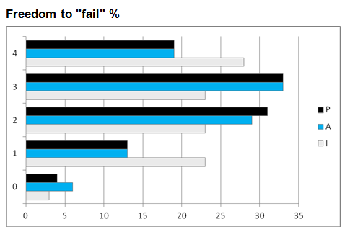
…..questionnaires: e-Learning….

Slide 17
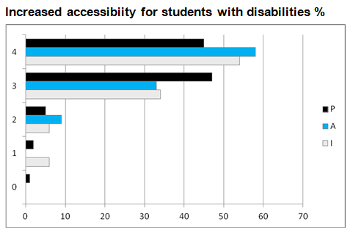
…..questionnaires: e-Learning….

Slide 18
…..questionnaires: e-Learning….
Respondents were also asked to rate, in a scale from 0 to 4, the challenges posed by e-learning.

Slide 19
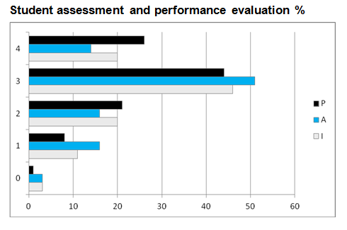
…..questionnaires: e-Learning….

Slide 20
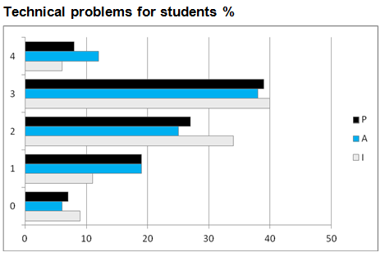
…..questionnaires: e-Learning….

Slide 21
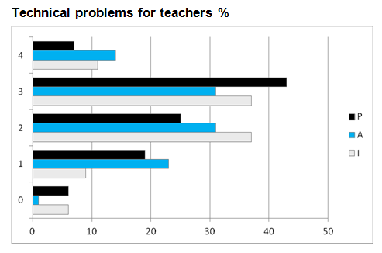
…..questionnaires: e-Learning….

Slide 22
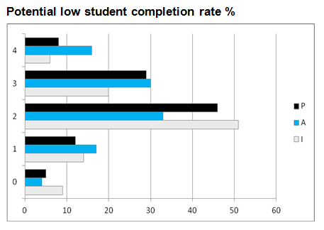
…..questionnaires: e-Learning….

Slide 23
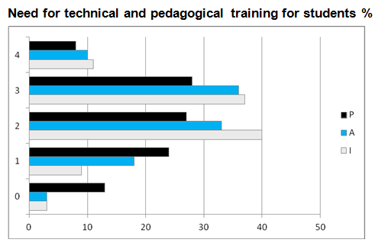
…..questionnaires: e-Learning….

Slide 24
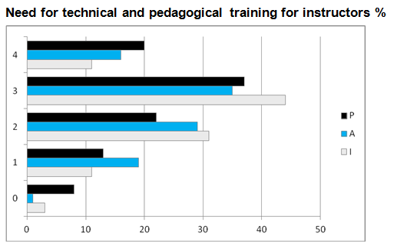
…..questionnaires: e-Learning….

Slide 25
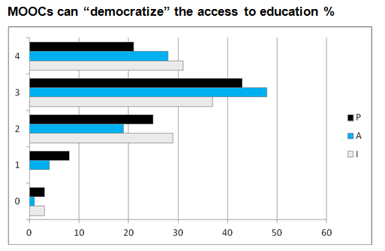
Questionnaires: MOOCs…

Slide 26
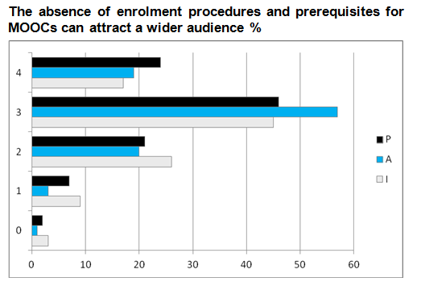
Questionnaires: MOOCs…

Slide 27
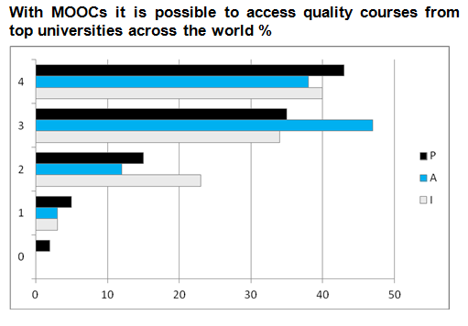
Questionnaires: MOOCs…

Slide 28
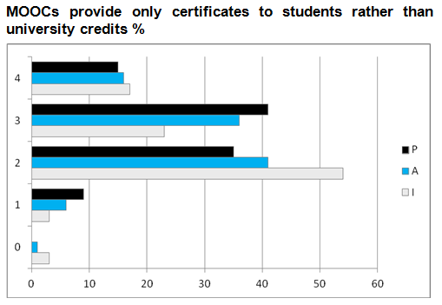
Questionnaires: MOOCs…

Slide 29
DISCUSSION Some Remarks…
The percentages of the three categories of respondents who agreed on the good qualities of e-learning are very similar
in most cases > 75% (levels 3+4 together)
the actual or potential advantages of e-learning are well acknowledged by both the academic world and its “users” (i.e. students and their prospective employers)

Slide 30
DISCUSSION Some Remarks…
Also the percentages of the three categories of respondents who agreed on the challenges of e-learning are similar, with two exceptions:
Potential low student completion rate: about 46% of alumni (levels 3+4) consider it a real problem, as opposed to about 37% of professors and 25% of industry representatives .
Need for technical and pedagogical training for students: about 46% of alumni and 48% of industry representatives consider it an actual issue, while only about 36% of professors think it is a problem.

Slide 31
DISCUSSION Some Remarks…
Alumni are generally better disposed than professors and industry representatives towards MOOCs
The fact that with MOOCs it is possible to access quality courses from top universities across the world is very appreciated by all three categories of respondents
The fact that MOOCs provide only "certificates" to students rather than university credits is considered a problem by about 40% of industry representatives, as opposed to about 56% of professors and 52% of alumni

Slide 32
CONCLUSION Limitations of the Study
Relatively low number of respondents for the three categories (95, 69 and 35, respectively)
Bias due to the fact that respondents are not uniformly distributed among countries
The study is more qualitative study than statistical…

Slide 33
CONCLUSION
Nevertheless, we think that it can provide some basic insights for a future.
More thorough (cross comparative) analysis of the perception of good and bad qualities of e-learning and MOOCs within the three groups.

Slide 34
Thank you
Questions , Comments and Suggestions are welcomed!

